Slide 1

8600-342: Developing Own Leadership Capability Using Action Learning
Business Administration

Slide 2

8600-342: Developing Own Leadership Capability Using Action Learning
Week Four
Notes:
Management Communication

Slide 3
Assignment Questions
Explain the nature and benefits of action learning (8 marks)
Explain the responsibilities of an individual within an action learning set or group including confidentiality and respect for others (4 marks)
Identify own leadership strengths and limitations based on an assessment of own leadership behaviours and potential (12 marks)
Set personal goals for an extended action learning intervention (8 marks)
Prepare individual action learning plans for involvement in action learning sessions for a minimum of twenty hours (12 marks)

Slide 4
Assignment Questions
Complete planned actions to improve leadership (16 marks)
Monitor and record own participation in action learning sessions (16 marks)
Use feedback from others and own personal reflections to review the effectiveness of action learning undertaken (16 marks)
Identify follow up actions required to continue the leadership journey (8 marks)

Slide 5
Content
Leadership Development
Key Concepts in Leadership Development
Succession Planning
Key Objectives for The Organization and individuals
Leadership Development Module
Develop Action Plans
Write a Professional Development Plan
Class Activity

Slide 6
Leadership Development
Leadership development refers to any activity that enhances the quality of leadership within an individual or organization. These activities have ranged from MBA style programs offered at university business schools to action learning, high-ropes courses and executive retreats.
Traditionally, leadership development has focused on developing the leadership abilities and attitudes of individuals
Different personal traits and characteristics can help or hinder a person's leadership effectiveness] and require formalized programs for developing leadership competencies Yet everyone can develop their leadership effectiveness. Achieving such development takes focus, practice and persistence more akin to learning a musical instrument than reading a book.

Slide 7
Leadership Development
A good personal leadership development program should enable you to develop a plan that helps you gain essential leadership skills required for roles across a wide spectrum from a youth environment to the corporate world
The success of leadership development efforts has been linked to three variables:
Individual learner characteristics
The quality and nature of the leadership development program
Genuine support for behavioural change from the leader's supervisor

Slide 8
Key Concepts in Leadership Development
Experiential learning: positioning the individual in the focus of the learning process, going through the four stages of experiential learning as formulated by David A. Kolb: 1. concrete experience 2. observation and reflection 3. forming abstract concept 4. testing in new situations.
Self efficacy: The right training and coaching should bring about 'Self efficacy' in the trainee, as Albert Bandura formulated: A person's belief about his capabilities to produce effects
Visioning: Developing the ability to formulate a clear image of the aspired future of an organization unit.

Slide 9
Succession Planning
Succession planning requires a sharp focus on organization's future and vision, in order to align leadership development with the future the firm aspires to create. Thus successive leadership development is based not only on knowledge and history but also on a dream.
For such a plan to be successful, a screening of future leadership should be based not only on "what we know and have" but also on "what we aspire to become". Persons involved in succession planning should be current leadership representing the vision and HR executives having to translate it all into a program

Slide 10
Succession Planning
According to Meir Jacob and Amit Cohen (1995) three critical dimensions should be considered:
1. Skills and knowledge
2. Role perception and degree of acceptance of leading role
3. Self-efficacy (Albert Bandura).
The development of "high potentials" to effectively take over the current leadership when their time comes to exit their positions is known as succession planning. This type of leadership development usually requires the extensive transfer of an individual between departments. In many multinationals, it usually requires international transfer and experience to build a future leader.

Slide 11
Key Objectives for The Organization
Identifying pockets of talent throughout an organization and directing them through career development and succession planning programs.
Grooming individuals that show high potential
Assist employees in developing and increasing their self-awareness so that they have a better understanding of their own strengths and weaknesses.
Create leaders and encourage individual autonomy at increasingly lower levels within the company.
Train managers to be highly successful and creative mentors and coaches.

Slide 12
Key Objectives for The Individual
Be more proactive about self-development
Take more control of one's career
Pursue self-development because it is important and use it as a motivational tool for goal achievement.
Participate in an active career development partnership with one's employer.
"Retool" yourself for the current workplace: enhance your ability to manage change, take risks, collaborate, build partnerships and teams, and so forth.

Slide 13
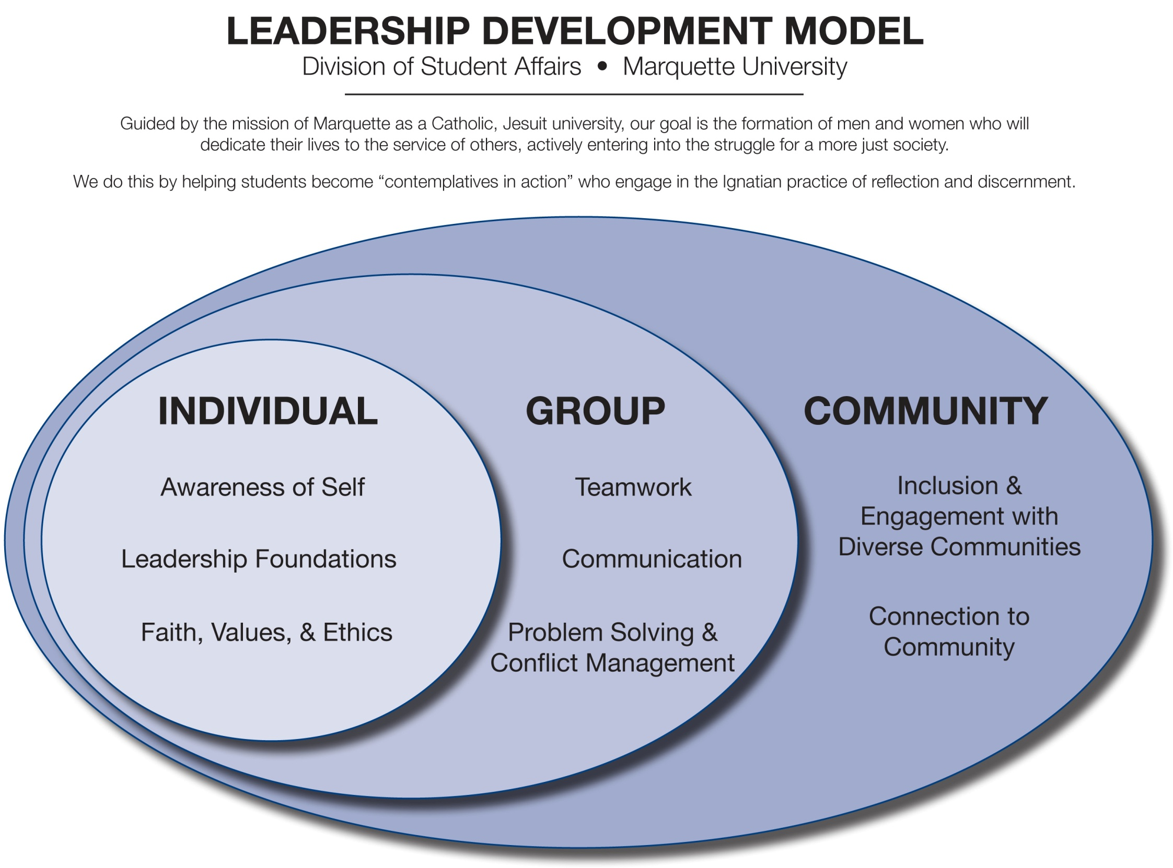

Slide 14
Individual Values
Awareness of self Identifying and articulating gifts, talents, values & skills; demonstrating openness to change; seeking feedback; appreciating multiple leadership styles; identifying opportunities for growth
Leadership Foundations Understanding theories about leadership; articulating a personal leadership style; understanding cultural and gender influences on leadership; developing personal management skills (e.g. time management, stress reduction, effective communication; developing relationships, problem solving, etc.)
Faith, Values, & Ethics Articulating relationship of faith to leadership; making decisions based on values; demonstrating congruence between faith/values and actions; identifying and applying ethical principles; appreciating diversity of faith traditions; demonstrating commitment to justice

Slide 15
Group Values
Teamwork Understanding group dynamics and development; working with others toward goals; sharing leadership and empowering others; developing trust and collaboration
Communication Motivating and empowering others through writing, speaking, and artistic expression; articulating abstract ideas; listening effectively; identifying common purpose and shared goals
Problem Solving &Conflict Management Understanding dynamics of group decision making; gathering information from diverse sources; managing and resolving conflict with civility; thinking critically; openness to change; demonstrating empathy and respect for perspective of others

Slide 16
Community Values
Inclusion & Engagement with Diverse Communities Interacting effectively with people from diverse backgrounds; integrating perspectives and experiences of others in group and community decisions; demonstrating empathy and respect for others; involving diverse individuals and groups in community activities and decisions
Connection to Community Using one’s talents to benefit others; demonstrating commitment to community through quality and quantity of interactions; giving of oneself in service to those in need; reflecting and reacting to the needs of the community and challenges of service; demonstrating advocacy in community issues

Slide 17
Develop Action Plans
If you have more than one objective, start with the one that the group considers the most important and/or complex. Develop a detailed plan for fulfilling the objective by the target date.
Identify what information, not already available, is needed to meet that objective
What is your objective, or more specifically, what tasks needs to be done to reach your goal?
Identify the steps needed to accomplish the goal in the order that they need to be done
How will your objective(s) be accomplished?

Slide 18
Develop Action Plans
Determine what individuals or groups in the organization will be involved in the implementation of the plan, then decide who will be responsible for what phases of the action plan
What are your resources in terms of people, money, materials?
Set a deadline for each step
When will each task be accomplished and what is the ultimate deadline?
Who is responsible for completing each task?

Slide 19
Develop Action Plans
Evaluate the goals or the people doing them periodically to check their progress and make sure members are working to achieve them
What results do you expect and how will you measure the effectiveness of those results?
Conduct an evaluation of the goals by the end of the year; from that evaluation make recommendations for next year's group
By setting goals, developing action plans, working to fulfil them, and evaluating the process, you and your organization will be more likely to succeed in your tasks.

Slide 20
Write a Professional Development Plan
The first step you will want to take is to take a self evaluation. Focus not on goals or weaknesses, but rather on strengths. Think about what you are good at. It will be easier for you to do things you love than to try to perform well in activities you have no interest in and aren’t very good at.
You aren’t expected to be good at everything, so acknowledging that you have weaknesses is a good thing to do at this point, just remember that it isn’t the focus of this exercise.

Slide 21
Write a Professional Development Plan
Decide on something that you want to learn, such as a new skill, or even a whole new job. Do some research on what it would take to learn this. Professional development can only happen with furthering education.
Look at material such as trade magazines, job descriptions and career guides. If you are trying to move up the corporate ladder, look into what other people in your company have had to do to move up the ladder. Next, identify the schools, seminars, mentors, blogs, books, and conventions that can give you what you need

Slide 22
Write a Professional Development Plan
Finally you can start to write out plans and goals. Try to write out a list of goals you would like to meet in the next five years and how you are going to reach them. This is your long term goals list, and should be kept somewhere safe that you can get back to easily. You will want to revaluate this regularly. Next write out a list of goals and how you will reach them for the next year. Make sure at least one of these things helps you reach one or more of the goals on your other list.
Finally write up a list of goals and how you will reach them for this next month. This should get you closer to one of your goals for the year. All of these should be revaluated and revised on a regular basis as your goals change.

Slide 23
Example of an Action Plan
1. Goal: To improve membership recruitment, retention and involvement.
2. Objective: To develop a committee whose purpose is to increase member involvement to at least 40% by next term.
3. How: Brainstorm ideas to increase member involvement. Go over this list and weed out all those ideas that are impractical or impossible to do. Discuss this edited list with the executive board. Determine which will be done and delegate the final process of setting up this system to one or two executive officers.
4. Resources: Members, executive officers, professional staff members, and advisors.

Slide 24
Example of an Action Plan
5. Deadlines: Who: Executive board
o When: By next term (try to set a specific date if possible).
6. Results:
o Acceptable - membership involvement increases by 40-70 %.
o Unacceptable - membership involvement increases by less than 40%.
o Better than expected - membership involvement increases by more than 70%.

Slide 25
Class Activity
1. Setting your action learning set
2. Appointed a facilitator
3. Start your meeting
According to the guide line, start your action learning process!

Slide 26
Setting Your Action Learning Set
Action learning sets are one approach that can be used to foster learning in the workplace.
A typical Action Learning Set will consist of 5 or 6 people who commit to work together over a period of at least six months. The set meets regularly (possibly every six weeks) for a day or half a day.
At each meeting, set members have an opportunity to introduce a challenge they are facing in their own practice.(As the requirement of assignment questions, all the group members should record the meeting memo individually and the learning log must be presented as on part of assignment)

Slide 27
Setting Your Action Learning Set
Over the period in which you are a member of the action learning set you should complete a learning log that includes a record of action learning set meetings attended including:
Those ‘problems’ that you brought to the set;
The actions that you agreed to take with the rest of the set’;
How you put those agreed actions into effect; and
How effective they were in helping you to improve your leadership performance.

Slide 28
Appointed a Facilitator
The role of the facilitator includes:
• Creating a “safe space” for honest discussion.
• Reminding set members of the methodology - ensuring the disciplined process is kept.
• Modelling helpful questioning.
• Ensuring that the questioning moves around the action learning cycle at an appropriate pace.
• Drawing attention to issues of process.
• Being conscious of time.

Slide 29
Start Your Group Meeting
Before the meeting, each member will think about the work-based issues that they wish to bring to the set.
• Members agree to set aside the necessary time for the meeting. It should be held in a space where they will be free from distraction.
• The facilitator might remind set members of ground rules that were established during the formation of the set, and may re-cap some of the key principles of the methodology if required.
• There will be a check-in with the group, and those who had an opportunity to explore their issue in the previous set will be asked to report back to the rest of the set on their actions since the last meeting.

Slide 30
Start Your Group Meeting
One of the members will then have an opportunity to have their “airtime”, which is usually an hour. This begins with them taking 5-10 uninterrupted minutes to outline the work based issue that they are bringing to the group.
During this process, the facilitator may sometimes “stop” the set, in order to raise awareness on matters of process, eg if people are giving advice packaged as questions.
At the end of the airtime, the person presenting their issue will feedback on how they experienced the process and what learning may have taken place.
The meeting may be concluded with the completion of an action review sheet which aims to capture key learning points and action plans from the meeting. The logistical details of the next meeting will also be agreed.

Slide 31
Reference
http://en.wikipedia.org/wiki/Leadership_development
http://www.creativeleading.com/leadership-objectives.html
http://www.marquette.edu/dsa/leadership/docs/Marquette_DSA_Leadership_Model.pdf
http://getinvolved.uky.edu/Leadership/pdf/Organizational%20Goal%20Setting.pdf
http://www.bond.org.uk/data/files/resources/463/No-5.1-Action-Learning-Sets.pdf
http://ohcm.ndc.nasa.gov/DevGuide/DevPrograms/Mentor/Mentoring_Action_Plan_workbook.pdf

